Slide 1
Omagh Forum for Rural Associations
33rd Annual General Meeting
Thursday 19th October 2023

Slide 2
Guest Speaker: Margaret Mc Closkey Money & Pensions Service (MAPS)

Slide 3
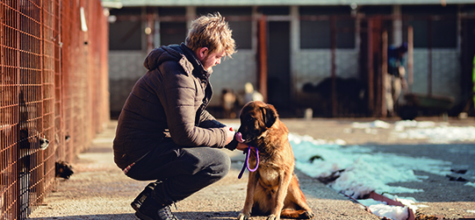
Legal Responsibility to implement a Financial Wellbeing Strategy Northern Ireland
Financial Foundations
Nation
of Savers
Credit Counts
Better Debt Advice
Future Focus
2030 NATIONAL GOAL
2030 NATIONAL GOAL
2030 NATIONAL GOAL
2030 NATIONAL GOAL
2030 NATIONAL GOAL
60,000
more
(up from 155,000)
children and young people getting a meaningful financial education.
35,000
more
(up from 254,000)
working- age ‘struggling’ and ‘squeezed’ people saving regularly.
37,000
fewer
(down from 164,000)
people often using credit to buy food or pay bills.
35,000
more
(up from 30,000)
people accessing debt advice.
120,000
more
(up from 560,000)
people understanding enough to plan for, and in, later life.
3
OECD G20 rankings

Slide 5
NI Financial Wellbeing Survey 2021 your money
13%
26%*
often use a credit card, overdraft or borrow money to buy food or pay bills because they have run short of money
couldn’t pay unexpected bill of £300 from spare money or affordable borrowing
51%
55%
with bills or credit commitments struggle to keep up, are falling behind or have fallen behind with their commitments
could last three months or more without borrowing if they lose their main source of income
50%
60%*
do not feel confident managing their money
do not have a plan for their finances in retirement
* based on working age population

Slide 6
There is a strong relationship between Financial Wellbeing Indicators & Mental Health Wellbeing
74% of people who experience a mental health problem struggle to keep up with bills and payments
25% of people who experience a mental health problem are likely to be in problem debt
91% of people who are struggling with their mental health avoid talking about money, often because they feel embarrassed, guilt or shame
Given the known links between mental health and money, we recommend normalising conversations about money to reduce these feelings
Adult FW Survey 2022 MaPS
The Facts (2019) Money and Mental Health Policy Institue

Slide 7
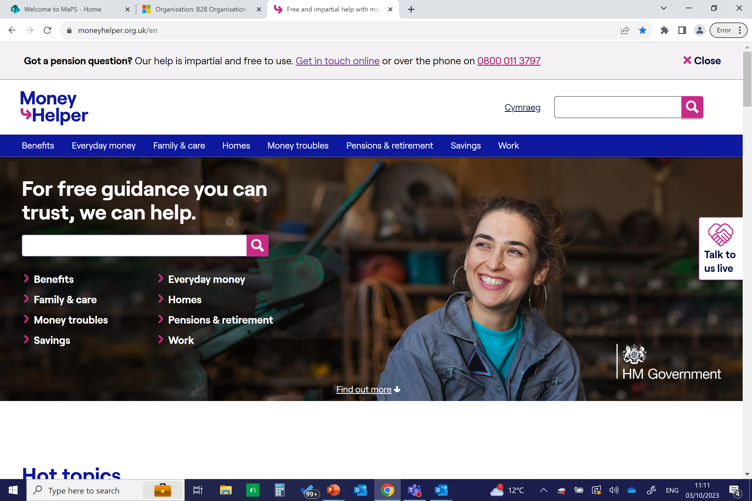
embed

Slide 8
Programme credentials
UK wide
Working with partners and in networks across England, Wales, Scotland and Northern Ireland
Government backed
Proven to work
City & Guilds recognition
Money Guidance Foundation Course
Notes:
Money Guiders is an ongoing programme, run by the Money & Pensions Service, an arms-length body supported by the Department for Work & Pensions
The programme is tailored for each of the four UK countries, with separate networks for England, Wales, Scotland and Northern Ireland
Money Guiders is proven to work over an 18-month pilot, and now has more than 5500 practitioners (and counting)
Online training offers organisations and practitioners a City & Guild endorsed credential (a digital badge) on completion of the Foundation modules and assessment. Recognition is coming for the Technical Tiers.

Slide 9
Money Guidance Competency Framework Available to download maps.org.uk/money-guiders
Foundation attributes set out the minimum level of skills and knowledge needed by anyone delivering any kind of money guidance.
Each of the 12 technical domains is tiered, according to the level of complexity at which a practitioner works.
All tiers can be self-identified, completely dependent on the depth and breadth of the money guidance you provide.
Notes:
The Money Guidance Competency Framework sets out the core competencies every Money Guider needs so they can provide a safe, quality service for their service users.
It is designed for anyone who provides any type of money guidance whatever their sector or job role.

Slide 10
Programme features
Our Money Guiders programme is free to use by any organisation, team or practitioner giving money guidance, rather than regulated financial or debt advice.
Framework and standards
Learning opportunities through:
Ongoing support
Competency Framework Setting out the skills, qualities and knowledge needed to give impartial money guidance in the non-regulated space.
Professional recognition Giving you the option to be assessed to gain City & Guilds credentials (digital badges).
Practitioner training E-learning modules based on the Framework, complementing any existing training and protecting practitioner wellbeing.
20 hours of learning available with more modules on their way
Networks and Communities Supportive networks in each of the UK’s four nations, turning knowledge into frontline practice.
Over 100 events per year UK-wide + Free resources to support you in delivering money guidance
Management resources Covering onboarding and inductions, along with dedicated resources and a digital dashboard to oversee team progress.
Regular communications Keeping you up to date on programme developments.
Always improving Listening and learning from programme partners to keep on enhancing Money Guiders for you.

Slide 11
Guest Speaker: Edel Browne PeacePlus Fermanagh and Omagh District Council

Slide 12
FERMANAGH & OMAGH PEACEPLUS LOCAL COMMUNITY ACTION PLAN PROPOSALS
Omagh forum for rural associations Thursday 19 October 2023

Slide 13
KEY FACTS
Budget: €5,671,195 Participants: 5671
Applications submitted by: 5pm 14 December 2023
PEACEPLUS Action Plans will support community led and designed projects which:
Develop cross-community local assets, services and projects
Deliver cross-community led solutions to tackle priorities that matter most to local people
Develop cross-community local interventions offering opportunity for social and community integration

Slide 14
Themes
Community Regeneration and Transformation
Enhancement to Existing Community Spaces/Halls Programme
Outdoor Recreational Capital Scheme
Capital Youth Programme
Thriving and Peaceful Communities
Activity Plan to complement each of the capital programmes
Capacity Building and Volunteer Training Programme
Connecting Communities through Well-being
Exploring our Local Heritage
PEACE Focussed Youth Programme
Protecting our Environment

Slide 15
Themes (continued)
Celebrating Cultures and Diversity
Exploration of Our Cultural Roots through Music
I Want you to know about Me
Healthy Relationships
Language Support Programme

Slide 16
MEANINGFUL AND PURPOSEFUL CONTACT
THE ACTION PLAN MUST SUPPORT MEANINGFUL, PURPOSEFUL AND SUSTAINED CONTACT BETWEEN PEOPLE OF DIFFERENT COMMUNITIES.
Contact should be worthwhile and have a function
Be of sufficient intensity to ensure a transformative experience
Single event – conference, workshop
Multiple event – tournaments, courses
Different communities relates to persons of different religious belief, ethnic or racial group. Initiatives should evidence commitment to tackling real and complex issues, such as racism and sectarianism, which prevent the benefits of a united and shared community being realised.

Slide 17
ESTIMATED TIMEFRAME
Closing Date – 14 December 2023.
Assessment SEUPB – May 2024
Letter of Offer – June 2024
Final Development - September 2024
Programme Activity commencement – September 2024 onwards

Slide 19
Omagh Healthy Living’s vision is:
‘A healthy Omagh & District’
Its mission is:
‘To improve the health of all residents of Omagh and district through leadership and collaboration to address the risk factors and health inequalities that contribute significantly to chronic disease.’

Slide 20
Introduction to the Team
Alaine Ward
Monitoring & Finance Officer
Tiernach Mahon
Project Coordinator
Kerrie Grugan
Social Prescriber

Slide 21
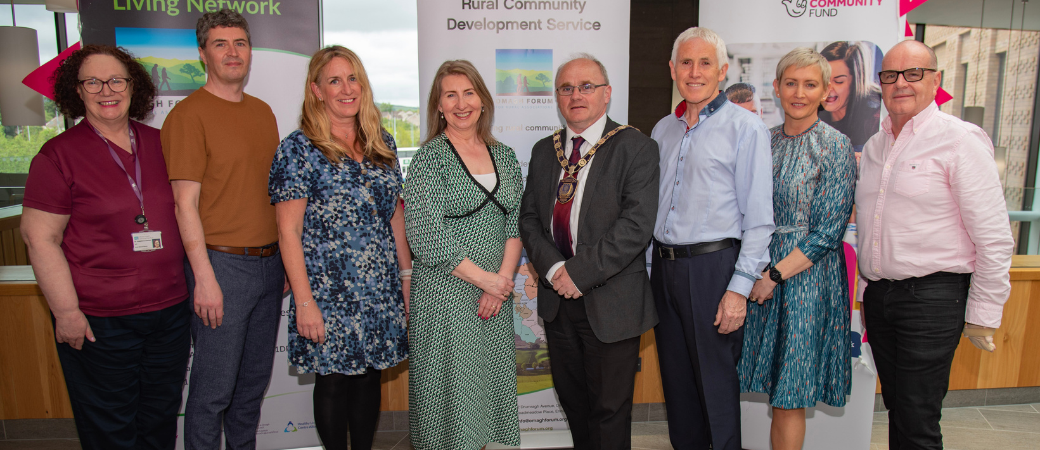
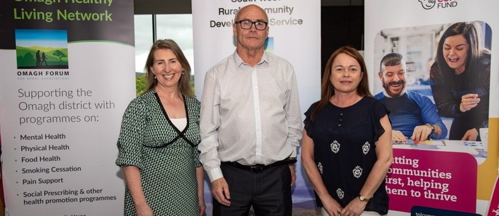
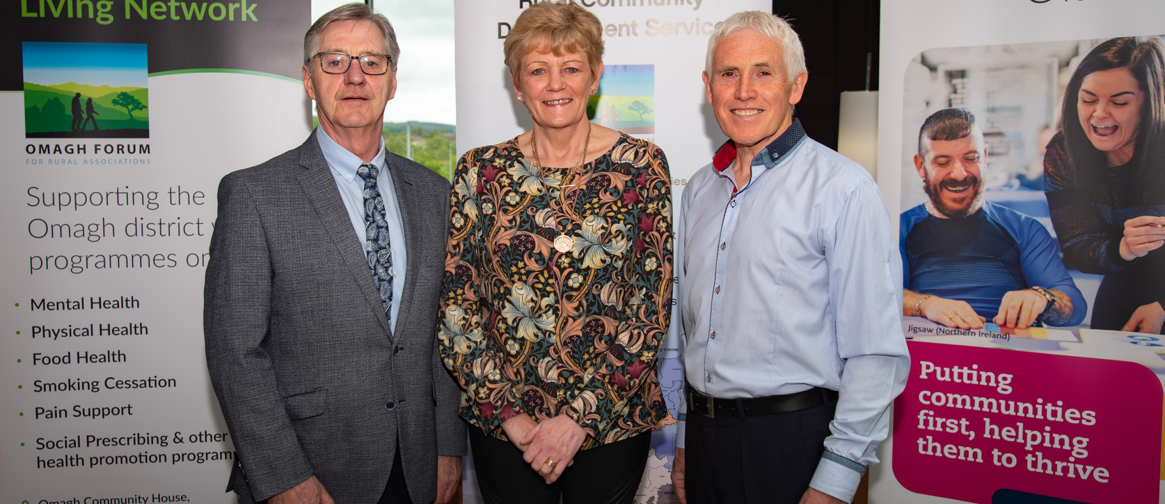
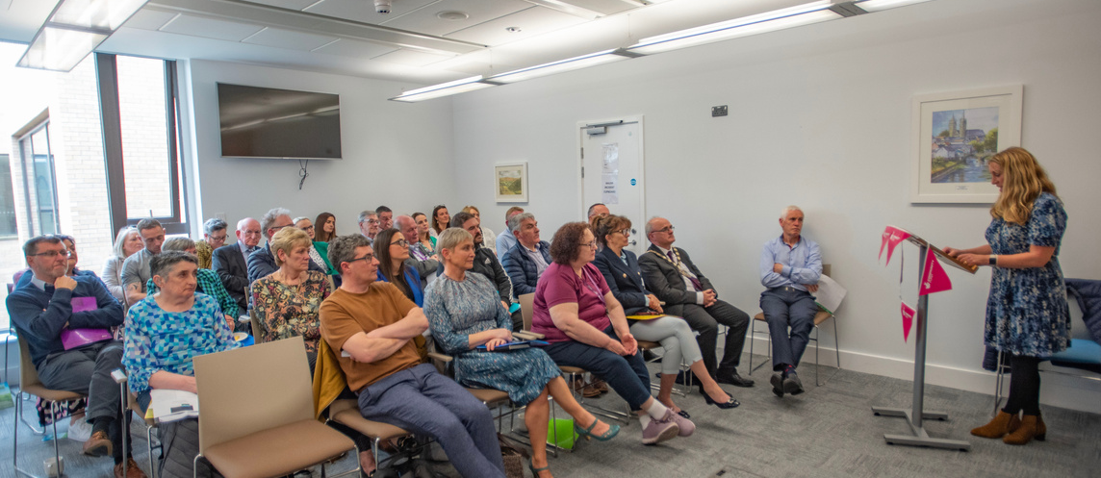
Omagh Healthy Living Network Launch...
Omagh Healthy Living Network received a funding boost thanks to a grant of £499,595 from The National Lottery Community Fund.
Launch of Omagh Healthy Living Network on Wednesday 24th May at 2.45pm at Omagh Hospital and Primary Care Complex
Omagh Healthy Living Network will deliver of a range of health promotion programmes across the rural and urban areas of Omagh as well as the roll out of Social Prescribing.
- Supporting the Omagh District with programmes on; Mental
Health, Physical Health, Food Health, Smoking Cessation, Pain
Management and Social Prescribing.

Slide 22
Where are we now....

Slide 23
What is Social Prescribing...
‘a means of connecting people to a range of non-clinical services and support in the community to improve their health
and well-being.’

Slide 24
Social
Prescribing.....
Signposting
A directory of services
Activities to fill someone’s time now and then
is not just
is not just
Physical
Activity
Mental
Health
Social
Support
Diet &
Nutrition
Housing
Support
Debt and
Benefits Advise
Substance
Abuse
Employability
Support
Volunteer
Support
Gambling
Addiction
‘Better Physically, Better Emotionally, Better Connected’

Slide 25
Social prescribing - How will it work........
‘Addressing Health in a Holistic Way!’

Slide 26
Links to Wellbeing Programme
‘Links to Wellbeing’ is a two years project funded by NHS Charities Together and aims to support individuals waiting for orthopaedic surgery to maximise their physical, mental and emotional wellbeing in preparation for surgery.
13 Participants - Link to Wellbeing 8 Week Programme with Western Health and Social Care Trust (WHSCT) at Omagh Leisure Complex

Slide 27
What next....
Health & Wellbeing Programmes
Transform your trolley
Pain Support
Smoking Cessation
Cost of living
Meeting Primary Care representatives - GPs, Practice Managers, South West GP Federation
Ongoing meetings with C&V Sector, FODC, WHSCT, Housing

Slide 28
‘Health is made at home,
Hospitals are for repairs!’
Nigel Crisp, former chief executive of the NHS
Building a healthy and health-creating society.

Slide 29
Thank you!
Connect with us.
028 8225 1559
health@omaghforum.org
Omagh Healthy Living
Omagh Community House, 2 Drumragh Avenue,
Omagh BT78 1DP

Slide 30
Any Other Business

Slide 31
South West College Level 3 Extended Diploma in IT students are required to complete an IT project as part of their studies and our aim is that the students will get to work on a project where they will not only be able to put into practice skills learned in the classroom but also help a voluntary organisation. Therefore, we are reaching out to voluntary organisations to offer IT support with any of the following:• Produce posters to advertise events e.g. Christmas Craft Fairs. • Promote events on Social Media Platforms. • Create power-point presentations. • Set up excel spreadsheets. • Create databases. • Research e.g. any market research or surveys that need created, distributed and analysed. If any organisation has an IT project that they would like SWC Level 3 Extended Diploma in IT students to provide help with, please get in contact with anne-marie.donaghy@swc.ac.uk

Slide 32
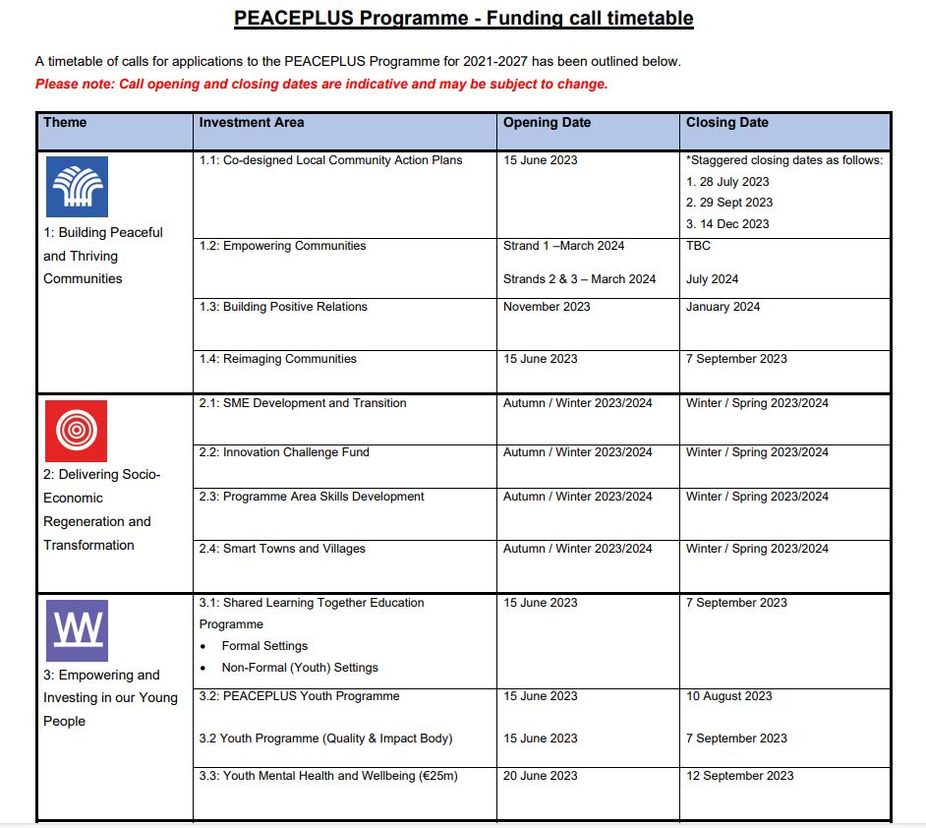

Slide 33
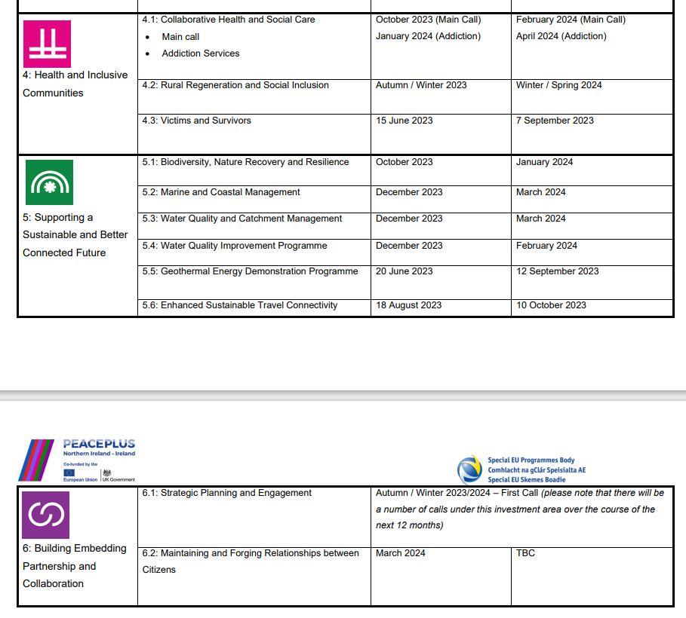

Slide 34
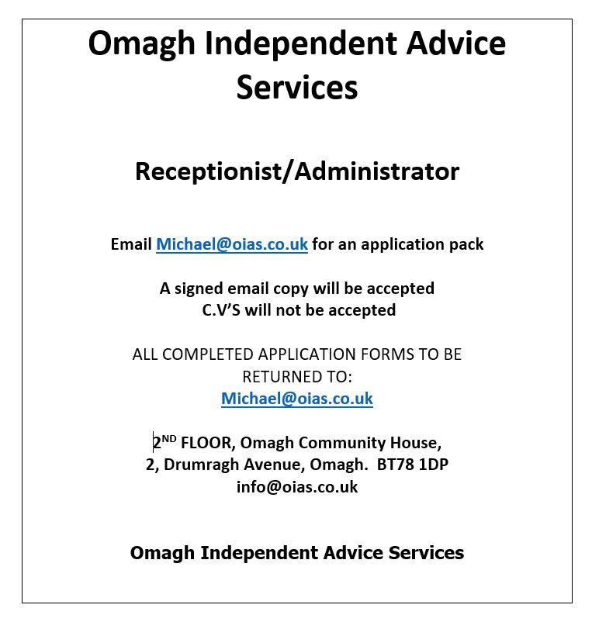
Job Opening

Slide 35
Thank you to everyone who attended and again to Mountfield Community Association for hosting our AGM.
Please relax, have a look around and chat while enjoying the light refreshments.

